Slide 1
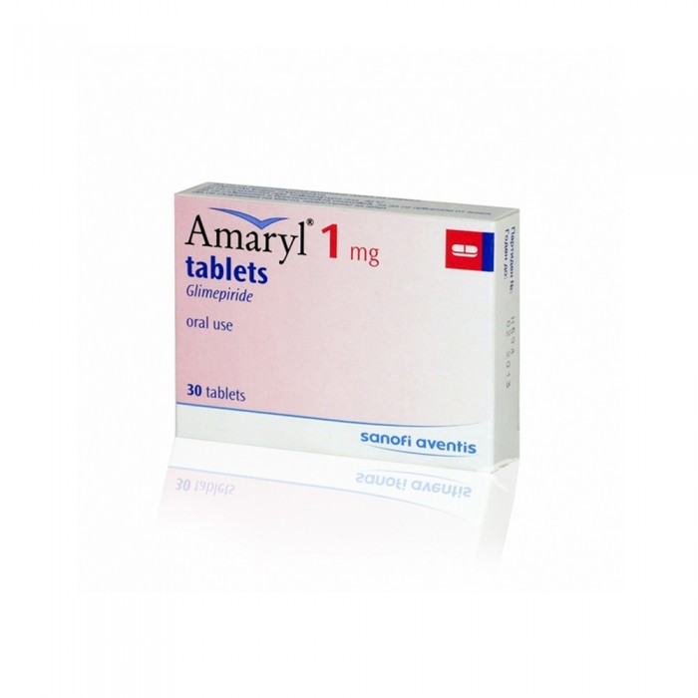
Amaril 1 mg
Amaryl 1 mg tablets - 30 pills
23.15 SAR. Q

Slide 2
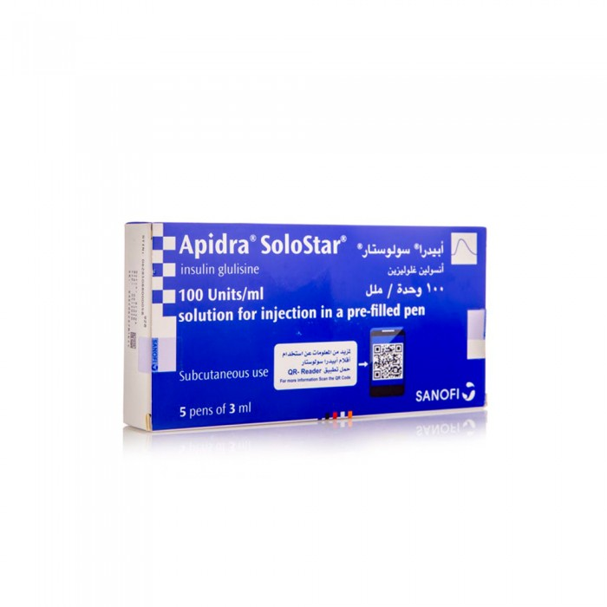
Abidra Solostar
Abidra Solostar 100 IU/ml 5 Pen * 3 ml (refrigerator)
169.10 SAR. Q

Slide 3
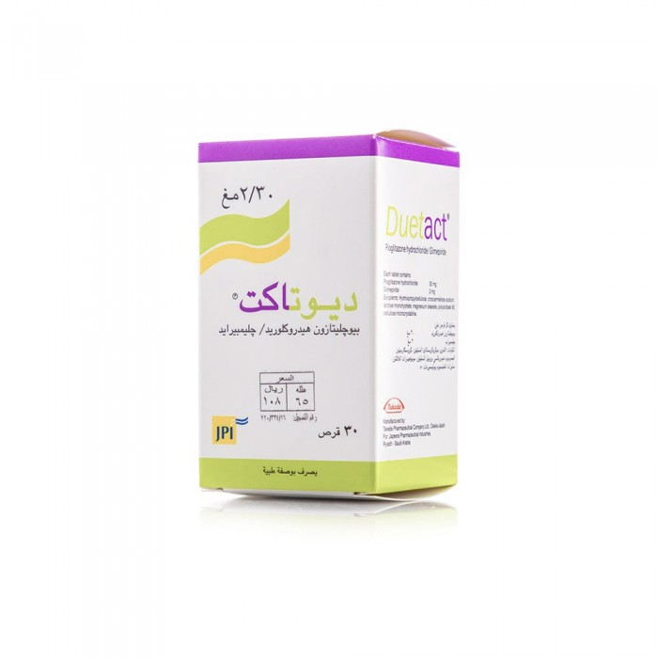
Deutakt
Deutakt 30/2 mg tablets 30 pills
108.65 SAR. Q

Slide 4
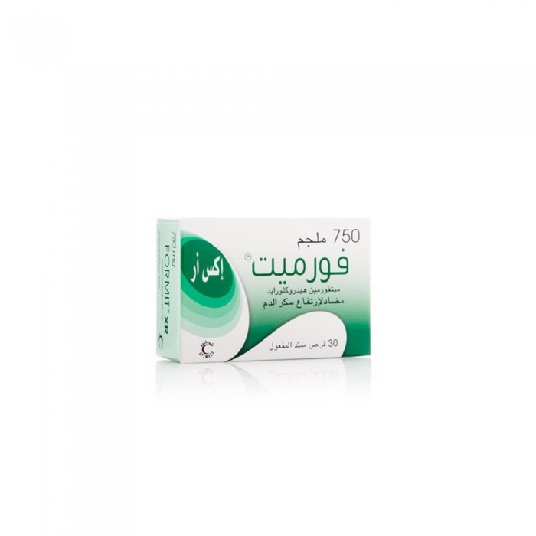
Formate
Formate XR 750 mg tablets 30 pills
SAR 19.10. Q

Slide 5
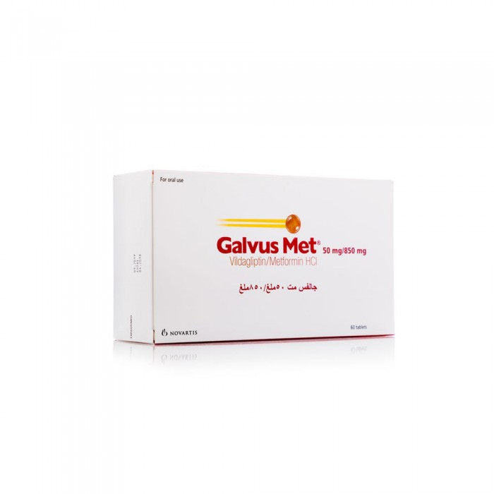
Galves
Galvs MT 850/50 MG Tablets 60 Pills
133.90 SAR. Q

Slide 6
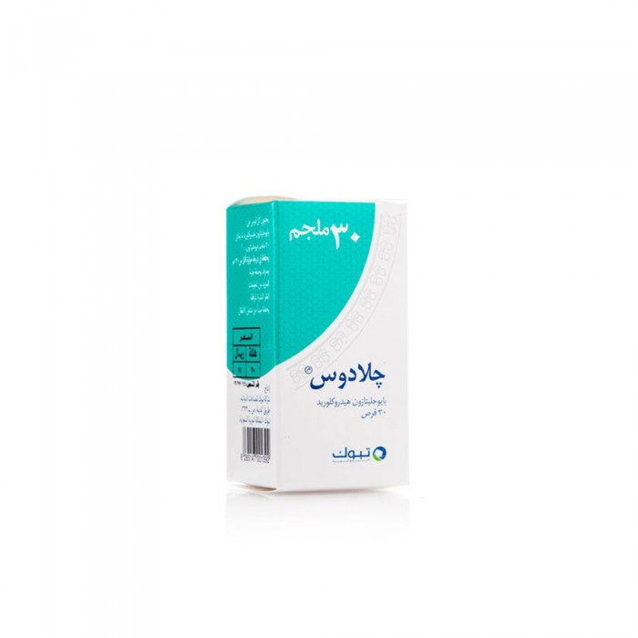
Glados
Glados 30 mg tablets 30 pills
71.30 SAR Q

